Slide 1
Trends of Diabetic Patient Compliance & Attendance of PCP Visits From 2020-2023
Elizabeth Upp
Louisiana State University Health Sciences Center – New Orleans, LA
School of Medicine, Class of 2024
AmeriHealth Caritas Louisiana Medical Intern

Slide 2
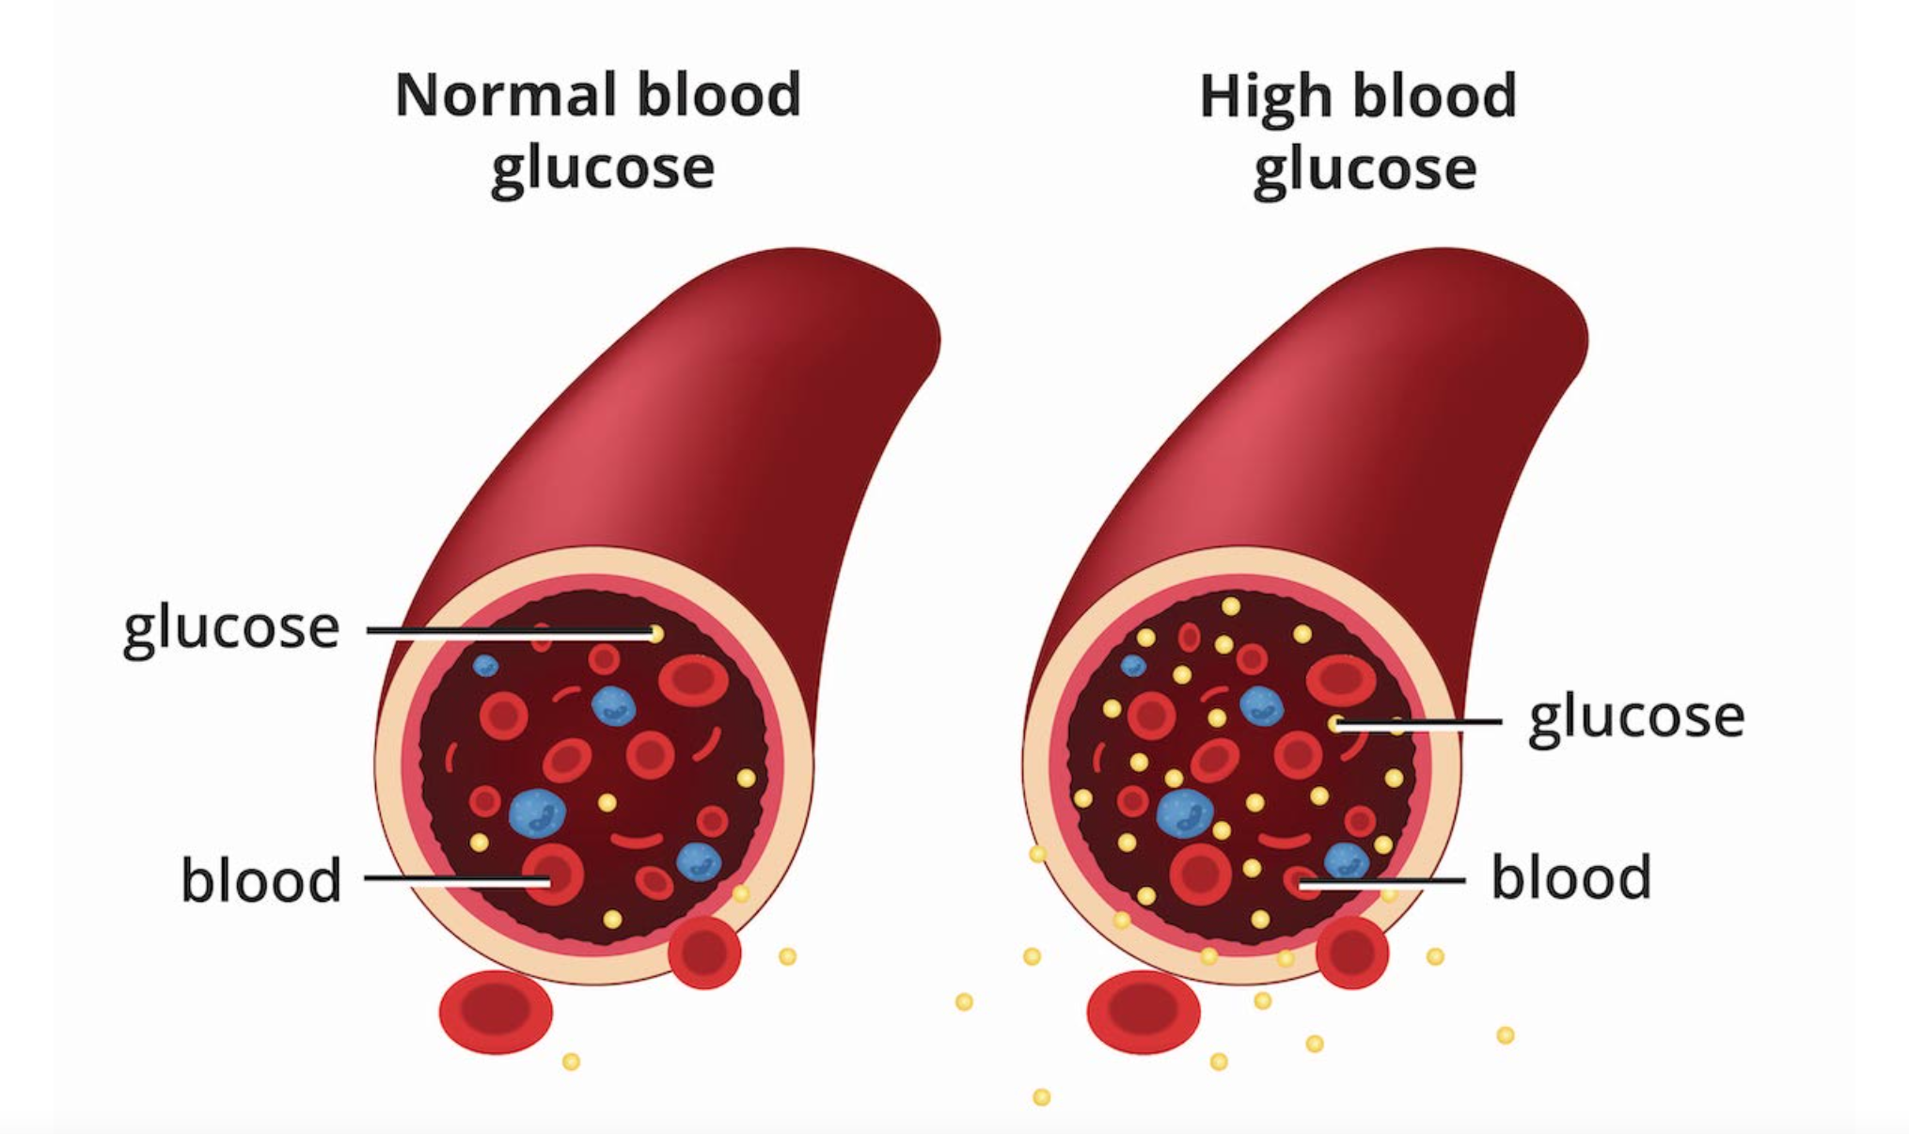
What is Diabetes?
Chronic health condition
The body does not make enough insulin (type 1 diabetes) or the body cannot use insulin as well as it should (type II diabetes) → too much blood sugar remains in the bloodstream
Hemoglobin A1c used to measure average blood sugar level over the past 2-3 months
HbA1c < 5.7% → normal
HbA1c 5.7%-6.4% → prediabetes
HbA1c > 6.5% → diabetes
Long term effects: heart disease, vision loss, kidney disease, and many more
Treatment
Take medicine as prescribed, lose weight, eat healthy, be active

Slide 3
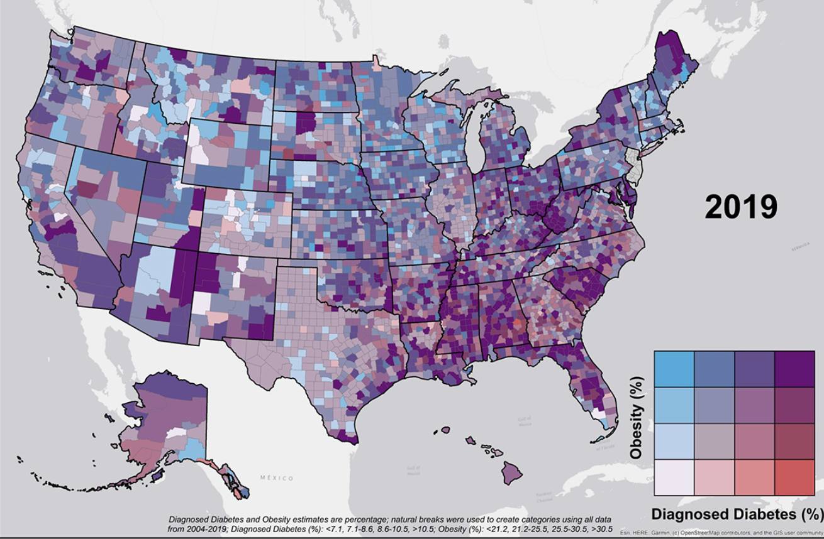
Diabetes In Louisiana
14.2% of the adult population diagnosed with diabetes
LA ranks 7th in U.S. diabetes prevalence
2.4% of the adult population has diabetes but do not know it
34.4% of the adult population have pre-diabetes
Notes:
Facts from the American Diabetes Association about diabetes in LA
Map of diabetes and obesity by county in the U.S. in 2019

Slide 4
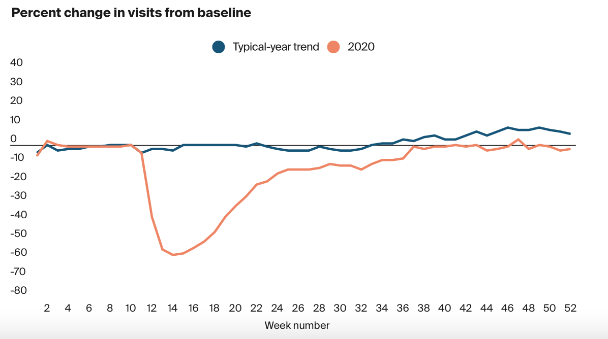
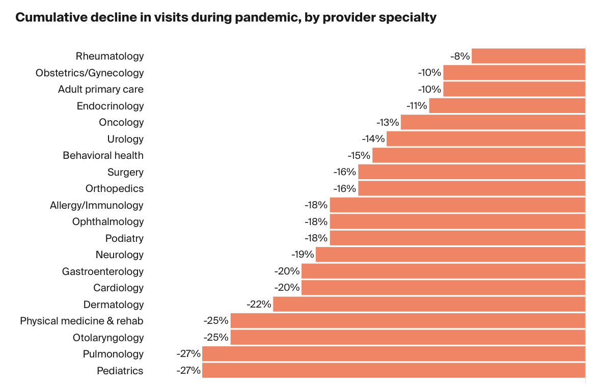
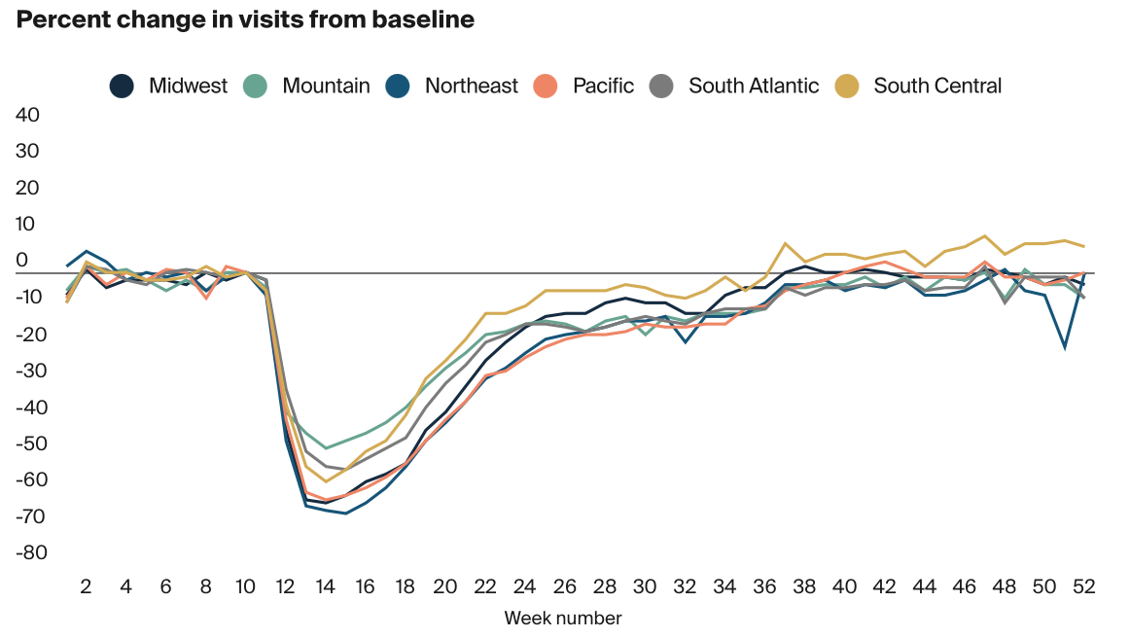
Impact of COVID-19 on Outpatient Visits in 2020
March 2020 → health care practices began deferring elective visits, modifying their practices to safely accommodate in-person visits, and increasing the use of telemedicine

Slide 5
Data Analysis
Population:
Members turning 18-75 years of age in the calendar year with diabetes (types 1 and 2)
Timeline:
2020-2023
Compliance:
Percentage of members whose most recent HbA1c level was < 8%
PCP Visits
Percentage of members who attended at least one PCP visit within a specific year
Caveat: Data only included PCP visits when a member saw their assigned PCP
I assumed that a member did not attend a PCP visit when the column was blank, however there is a possibility that they could have seen a different physician that they were not assigned to

Slide 6
Compliance vs. Attendance of PCP Visits

Slide 7
Effects of Race on Compliance & Attendance of PCP Visits

Slide 8
Effects of Language Spoken on Compliance & Attendance of PCP Visits

Slide 9
Effects of Rural vs. Urban Areas on Compliance & Attendance of PCP Visits

Slide 10
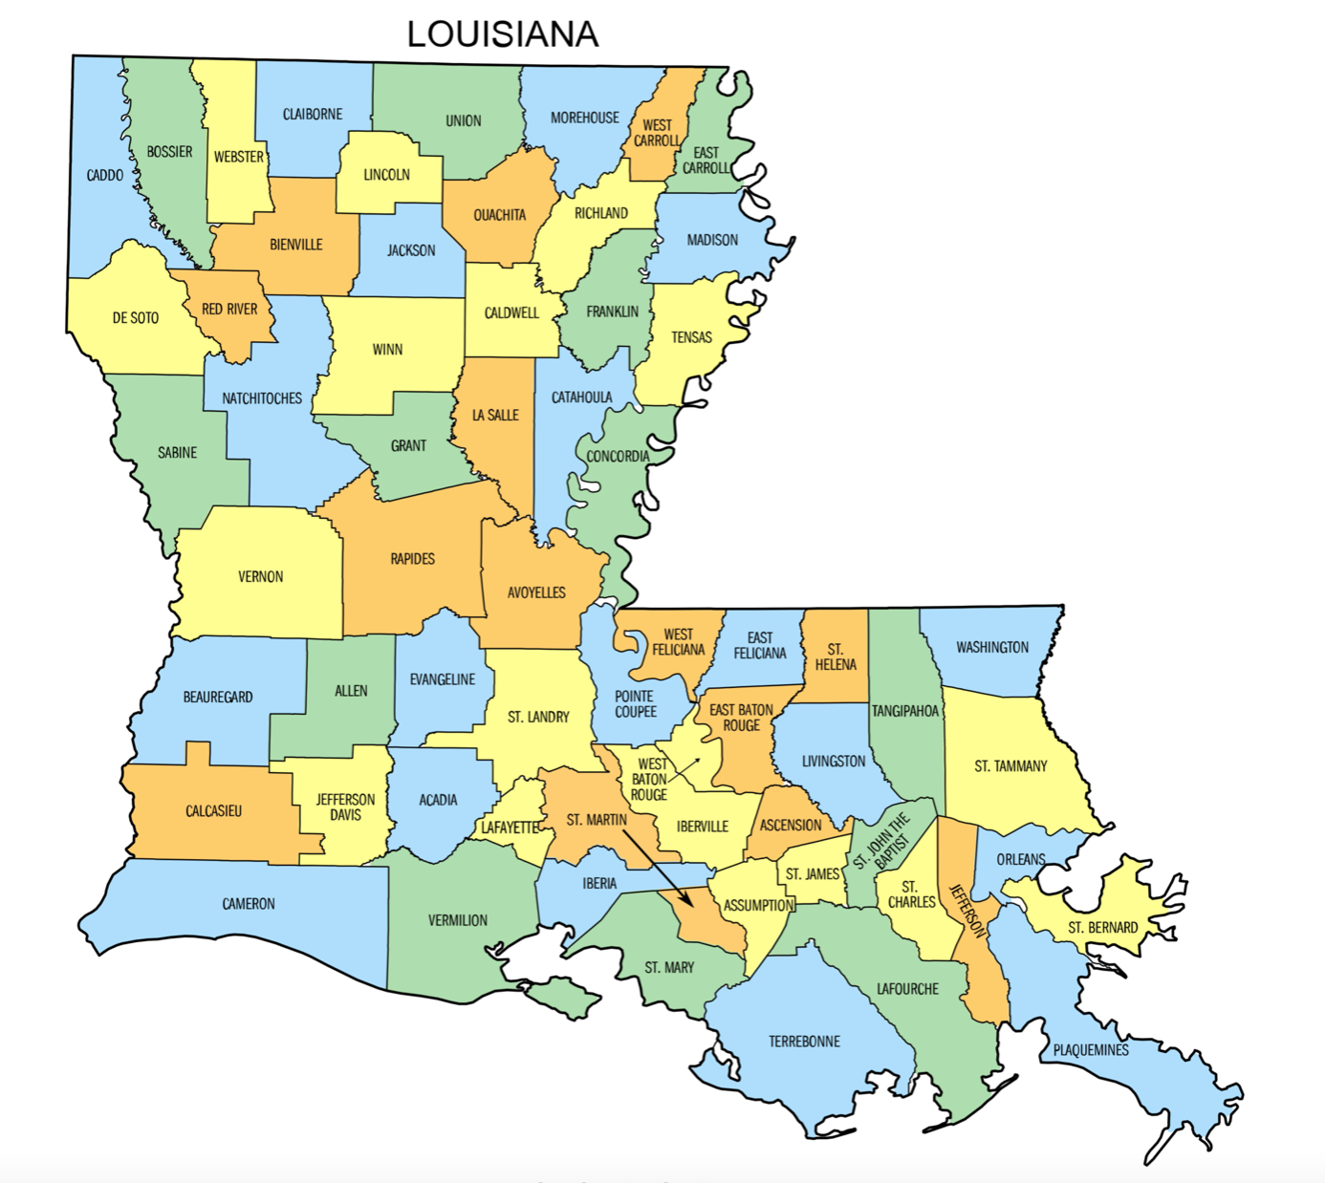
Rural Parishes with Average Compliance < 25% From 2020-2023
Parish | Average % of Compliant Patients from 2020-2023
Saint Mary | 25%
Lincoln | 23%
Vermillion | 19%
Webster | 9%
Franklin | 8%
*Richland parish had the highest average compliance percentage (51%) out of the rural parishes

Slide 11
Summary
The percentage of compliant diabetic patients has steadily increased since 2020
PCP visit attendance did not change much despite the pandemic and does not seem to be correlated with the increasing compliance of diabetic patients over the years
Effects of race (white vs. black) on diabetic patient compliance and attendance of at least one PCP visit were not very substantial
Compliance of Spanish speaking diabetic patients has improved over time
There is a growing disparity in the compliance of diabetic patients in rural regions compared to urban regions over time*

Slide 12
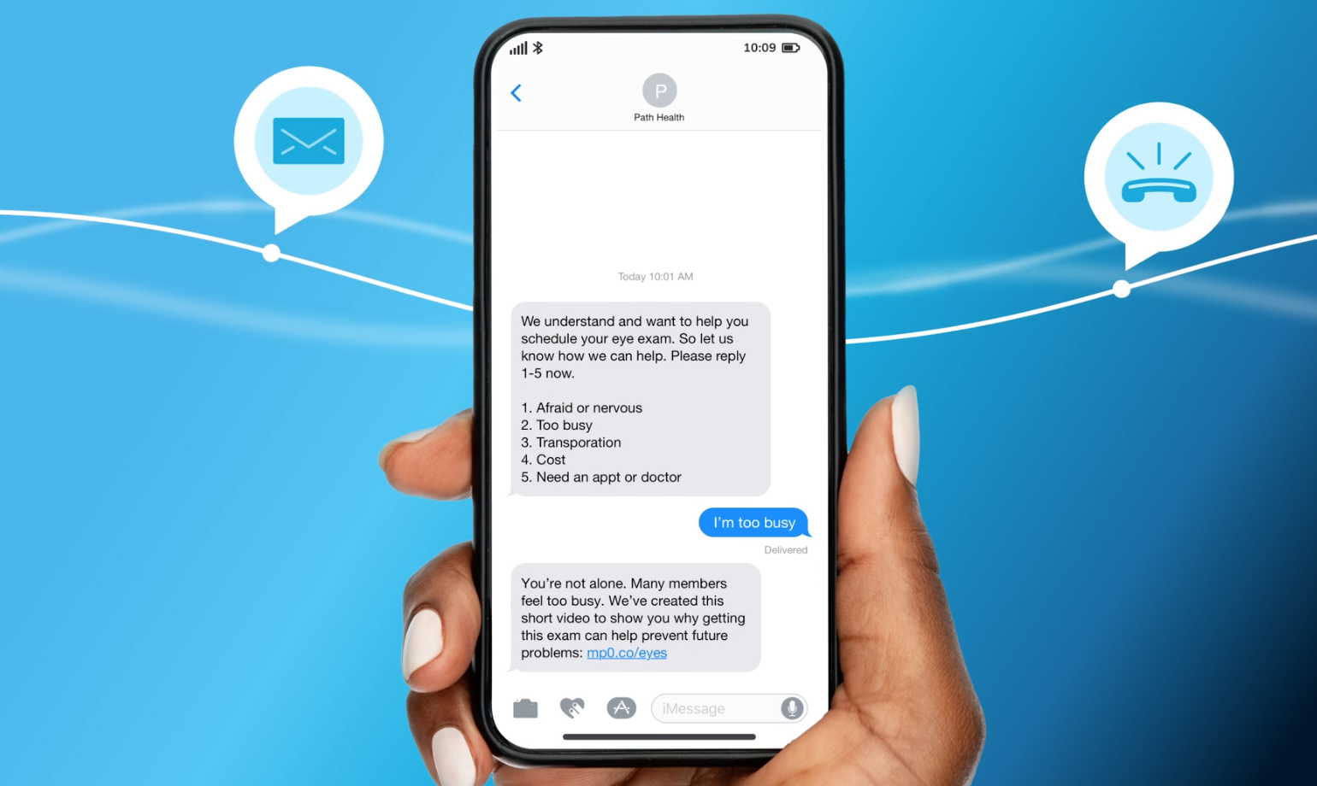
AclA Interventions
INTERVENTIONS
CLAS/HELS Interventions
Care Card Member Incentive
Case Management Program
Social Media Campaign
Text Messaging/Voicemail Calls

Slide 13
Recommendations
Utilize community health workers to provide diabetes education, support, and outreach services within rural areas, especially in Franklin, Webster, Vermillion, Lincoln, and St. Mary parishes
CPSTF recommends interventions that engage community health workers to help patients manage their diabetes because they have been shown to improve glycemic and lipid control, reduce health care use, and they are cost effective
Look into what interventions have been done in Richland parish
Continue to offer telehealth visits and home visits
Offer training and support programs for healthcare providers in rural regions to expand their knowledge and skills in managing diabetes effectively
Provide financial assistance to help patients in rural areas afford medications, insulin, glucose monitoring supplies, etc.

Slide 14
Thank you!
Dr. Gregory Randolph
Dana Smith
Renee Wells
Shea Good
Rhonda Baird
Lekitha Gregory
ACLA Quality Improvement Team

Slide 15
References
https://www.cdc.gov/diabetes/basics/diabetes.html
https://www.cdc.gov/diabetes/data/center/slides.html
https://www.commonwealthfund.org/publications/2021/feb/impact-covid-19-outpatient-visits-2020-visits-stable-despite-late-surge
https://www.thecommunityguide.org/findings/diabetes-management-interventions-engaging-community-health-workers.html#:~:text=Interventions%20include%20education%2C%20coaching%2C%20or,one%20interactions%20or%20group%20sessions.
https://www2.diabetes.org/sites/default/files/2021-10/ADV_2021_State_Fact_sheets_Louisiana.pdf
https://www.niddk.nih.gov/health-information/diabetes/overview/what-is-diabetes

