Slide 1
Peggy Honoré, DHA, MHA Endowed Professor School of Public Health School of Medicine phono1@lsuhsc.edu
Health Policy Honors Program

Slide 2
The Health Policy Honors Program provides LSUHSC medical students with: - A foundation in the basics of health policy analysis and research to better equip students for professional growth as physician leaders with skills to advance health system improvements through policy. - An academic experience for students expressing intellectual curiosity about the role and impact of policy on individuals and population health. - The practical and theoretical knowledge to recognize and actively participate as physicians in the role that policy plays in improving the health of populations and the context in which healthcare is practiced. - The unique ability to articulate an authoritative perspective on solutions to a health or health related problem.
GOALS

Slide 3
Requirements
3 Electives
Health Policy MCLIN 190 (L1)
Health Policy MCLIN (L2)
Health Policy MCLIN (L4)
Complete a 2-month policy fellowship in the summer following successful completion of all L1 requirements
Submit a Policy Honors Research Proposal and complete the work before 4th year
Write and submit to a peer reviewed journal a manuscript documenting research and analysis prior to January of 4th year.
APPLY By December 2020
https://sph.lsuhsc.edu/health-policy-honors-program/

Slide 4
My summer policy fellowship at the National Academy of State Health Policy was one of the best experiences I had during medical school.” Trevor Flynn (MD Candidate Class of 2020)
H o s t S i t e s
“The AmeriHealth Caritas Fellowship exposed me to another avenue to reach better health outcomes: health policy. Insights gained during my experience on Capitol Hill in the policy fellowship was often a topic of discussion during residency interviews with various faculty members at distinguished institutions while brainstorming ways to push medicine forward.” Sharis Steib, MD (Class of 2019)
TULANE Environmental Law Clinic

Slide 5
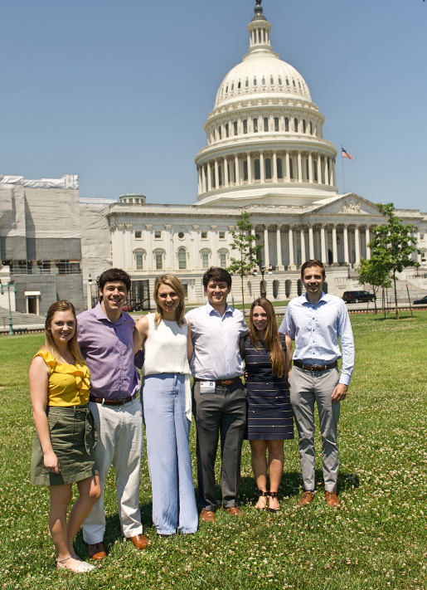
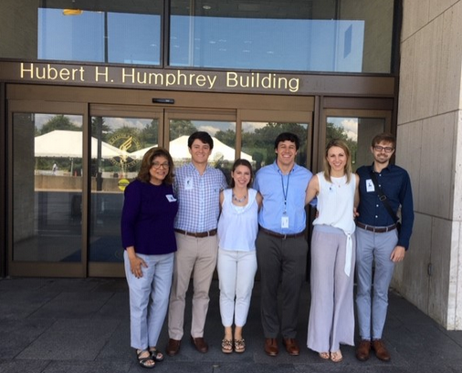
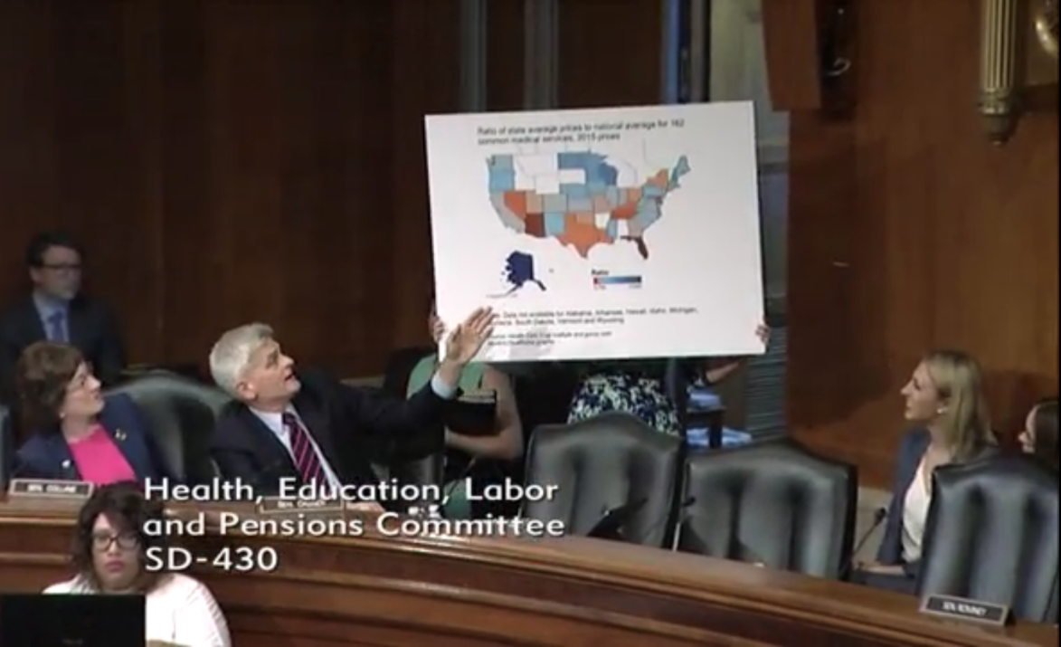
Building Advocacy and Policy Analytical Competencies for Medical Students at LSUHSC-NO
https://sph.lsuhsc.edu/health-policy-honors-program/

