Slide 1
Practice Experience Boot Camp
Do you have lingering questions about the MPH Practice Experience?
Attend this boot camp to learn about Practice Experience course work, due dates, forms, and much more.
Any questions you have will be answered
September 13, 2017
12:00noon-1:00pm
Lions Eye Clinic
Room 303

Slide 2
Practice Experience Boot Camp
Dr. Donna Williams, Associate Dean for Public Health Practice and Community Engagement
Amber M. Brown, MPH, Coordinator for Public Health Practice and Community Engagement

Slide 3
Content
Defining Practice Experience
Planning
Procedures and Forms
Deliverables “Products”
OneNote
Deadlines
Questions

Slide 4
Defining Practice Experience Defining Practice Experience
Practice-based learning
-Bridge academic training and applied public health practice
-Build skills, abilities, and professional network
-Inform career choices
Structured
-Planned
-Supervised/mentored by preceptor
-Evaluated
Competency driven
CEPH requirement
The MPH Practice Experience is a project or activity that immerses students in one or more aspects of public health operations under the guidance of a preceptor. It gives students an opportunity to apply what they are learning in a professional public health setting, while building skills, abilities and relationships.
Practice Experience is not administrative, shadowing, clinical, research, or an extension of a student worker position

Slide 5
Defining Practice Experience
PUBH 6800 = 3 Credits
Prerequisites
1 Semester*
Minimum 200 hours of fieldwork
Class meets twice a month
OneNote portfolio required
*Exceptions: work full-time, joint degree, formal internship
10 Credits
BIOS 6100 or BIOS 6200 [4 credits]
EPID 6210 [3 credits]
Program Core
ENHS 6238 [3 credits]
BCHS 6212 [3 credits]
HPSM 6268 [3 credits]
Code of Conduct
HIPAA
CITI

Slide 6
Planning
The Public Health Practice Office is available to help you along the way.
Reach out with any questions at any time.
*If the site is new and/or preceptor, student must submit New Site Data Form and/or submit preceptor CV/resume

Slide 7
Planning
Placement Sites
Adding a New Practice Experience Site
Organization, center, or program
-Government
-Non-Profit
-Private companies (environmental)
Devoted to health of populations
-Prevention of disease
-Promotion of health
-Advocacy for healthcare programs/ delivery of service
Additional procedures/requirements for international sites
-Start international PE planning early
If the site is no on the approved list, it must be reviewed for approval before a student can proceed with PE planning.
New Site Data forms are on the PE webpage.
-Form may also be requested from the PE coordinator.

Slide 8
Planning
Finding a site
Choosing a site
Networking
Advisor
Peers
Volunteering
Email blast
Approved site list on Practice Experience webpage
Identify an opportunity that interests you and will support your career goals
Consult with advisor and PE coordinator
New Site
-Submit New Site Data form to PE coordinator

Slide 9
Planning
Preceptor role
New preceptor
Orient the student to specific project goals and operational requirements
Explain the structure and function of the agency
Invite the student to agency, interagency, and community meetings
Supervise the student
Provide a model of professional work habits and attitudes
Evaluate student performance on forms provided
If the preceptor has never served in this role before, they must submit CV/resume to be reviewed for approval by PE course director.
Must be an experienced, practicing public health professional
-MPH (or equivalent degree) plus 3 years professional public health experience
-Bachelor’s in related field plus 5 years of professional public health experience

Slide 10
Procedures and Forms
Forms required to register
Submit forms to OneNote
Proposal*
-Signed by student, preceptor, and PE course director
Memorandum of Understanding*
-Defines roles and responsibilities of student and preceptor
-Must be signed by student and preceptor
New Site Data form for new sites*
CV/resume for new preceptors
*Forms are on the PE webpage
Give draft proposal to PE coordinator to review prior to obtaining signature from preceptor
No late forms accepted and no extensions permitted*
*Waiting on formal internships

Slide 12
Deliverables “Products”
Deliverables "products" will be submitted at the end of the semester and added to student's portfolio.
Use competencies selected on pages 2-4
Deliverables are tangible and functional products or a service that the organization can adopt
Activities that support the creation and completion of products for the organization's use
Multiple competencies can be associated with one deliverable “product.”

Slide 13
Example

Slide 14
Example

Slide 15
OneNote

Slide 16
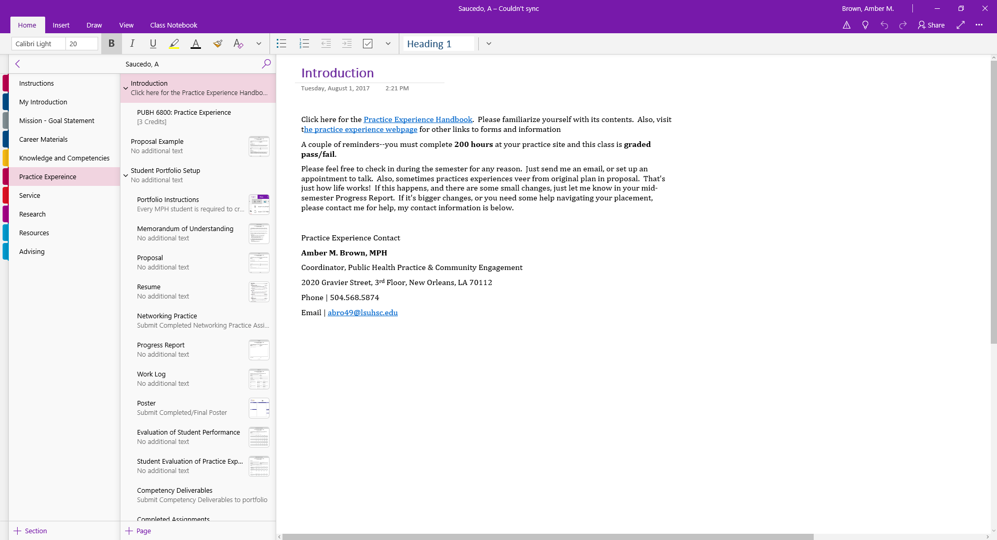
OneNote

Slide 17
Deadlines
Coincides with pre-registration
Important note
Deadline | Semester
Spring 2018 | November 15, 2017
Summer 2018 | March 28, 2018
Fall 2018 | June 20, 2018
Start early!
Notify PE coordinator of formal internships as soon as possible

Slide 18
Practice Experience Resources
http://sph.lsuhsc.edu/resources/student-resources/practice-experience/
Handbook
Approved Placement Sites
Forms
Public Health Practice and Community Engagement Office
Room 339
Email publichealthpractice@lsuhsc.edu
Phone 504-568-5874

Slide 19
Questions?

